Slide 1
Performance Improvement Opportunities Aimed at Quality Care
BY
Daisy Ouko

Slide 2
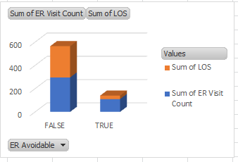

Opportunity One: Reducing Avoidable ER Visits
The avoided ER arrivals are still quite high
This reduces the speed and time needed to care for true emergencies
Avoidable ER also takes up medical personnel that can be deployed elsewhere
Reducing avoidable ER improve patient care time, reduces waiting and saves more lives

Slide 3
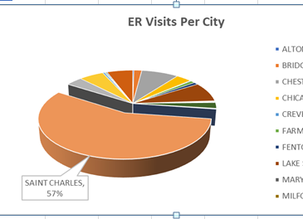
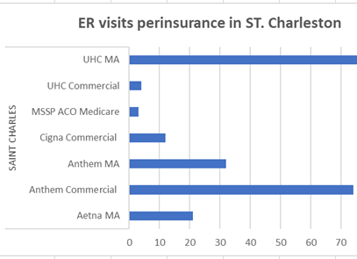
ER Visitations per city
St. Charles has More than half of the total visits
United health Medicare(UHMA) contributes the highest avoidable ER
More ER patients at St. Charles had UHMA cover
Respiratory diseases contribute the highest diagnosis in the ER

Slide 4

Recommendations
United health Medicare cover to increase capacity in covering patients with existing respiratory diseases
Patient education on improving outcomes when living with respiratory diseases
Develop a quality improvement initiative specific to ST. Charles that uniquely reduces ER visits in the city

Slide 5
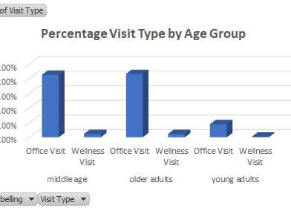
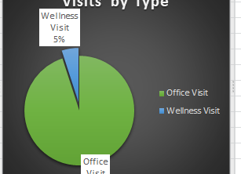
Opportunity Two: Increasing number of wellness visits
Wellness visits are extremely low; five percent of total visits
As a result, preventive care is also low
Patient outcomes improve with preventive care
Middle age and older adults have approximately similar wellness visits
Young adults wellness visits are extremely low at 0.43% of the total young adutls visits

Slide 6
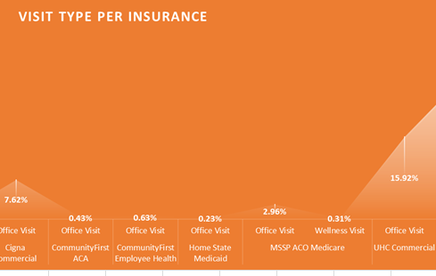
Wellness and office visits Per Insurance
Low wellness visits compared to office visits across all insurance providers
Three lowest wellness visits are for home state Medicaid, MSSP ACO Medicaid, and anthem MA
Home state Medicaid has the least wellness visits

Slide 7
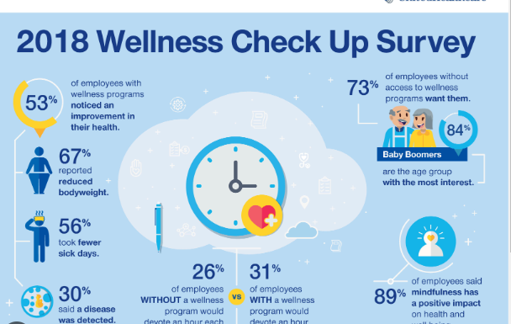
Recommendations
Heighten wellness importance education in facilities and local media
Develop focused wellness importance material for education young adults in high school colleges and universities
Provide incentives in home estate Medicaid, extra cover for patients that go for annual wellness checks
Develop insurance packages for whole family wellness checkups

